Slide 1
Automatic Lens Smear Detection
NITAL BANSODE (A20427196)
ABHISHEK VANDADI (A20426749)
AMITDEB BHATTACHARYA (A20402789)
KARTHIK MAHESH (A20383027)

Slide 2
Problem
Input : A sequence of Street view images.
Output : A mask on the smear on the lens.

Slide 3
Approach
1 . Implement Image averaging on the sequence of input images and use Gaussian Blur/Gaussian filter for smoothening.
2 . Implement Adaptive Thresholding on the output of Gaussian filtered image.
3 . Use Canny Edge detector for edge detection of smears.
4 . Draw contours across the edges detected to demonstrate the smear.

Slide 4
Flow Chart of the approach
Image Averaging
Adaptive Thresholding
Edge Detection
Smear Detection

Slide 5
Step 1 : Image Averaging
Image averaging is the noise reduction technique used to remove random noise in the image.
It is computed based on the arithmetic mean of pixel values of the sequence of the images that is given as an input.
The resulting image has lower noise and better signal to noise ratio(SNR) improving the bit depth of the image.

Slide 6


Averaged Image
The resulting output Fig.1 depicts the averaged image after summation of all images from cam_3.
Fig.2 shows the smoothening of the image taking averaged image as input.
Fig.1. Averaged Image
Fig.2. Gaussian filtered Image

Slide 7
Step 2 : Adaptive Thresholding
Adaptive thresholding will take a grayscale or color image as input and, gives a binary image as output representing the segmentation by calculating the threshold for each pixel in an image.
Adaptive Thresholding is used to segment an image by setting all pixels whose intensity values are above a threshold to a foreground value and all the remaining pixels to a background value.

Slide 8

Adaptive Threshold image
The Fig.3 is the result after performing adaptive thresholding on output of Gaussian filtered image.
Fig.3. Adaptive threshold image

Slide 9
Step 3 : Edge Detection
Canny edge detection is a technique used to extract essential structural information from an image and reduces the amount of data to be processed.
The Canny detector is use to catch accurately as many possible edges in an image by tracking across the edge points through localizing the center of edge of an image.
The Canny edge detection prevents the false detection and prevention of noise through its precise edge points.

Slide 10
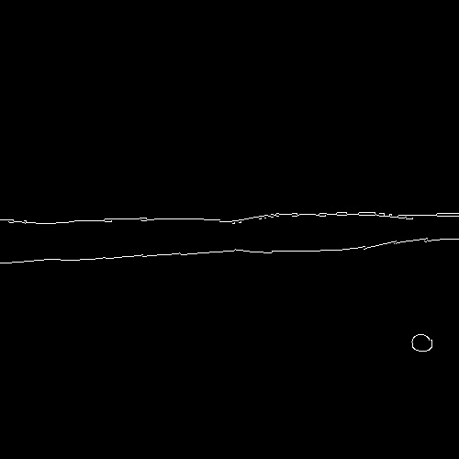
Edge Detection (Cont..)
The Fig.4 is the image detecting the outer edges of smear of the adaptive thresholding image.
Fig.4. Edge Detection

Slide 11
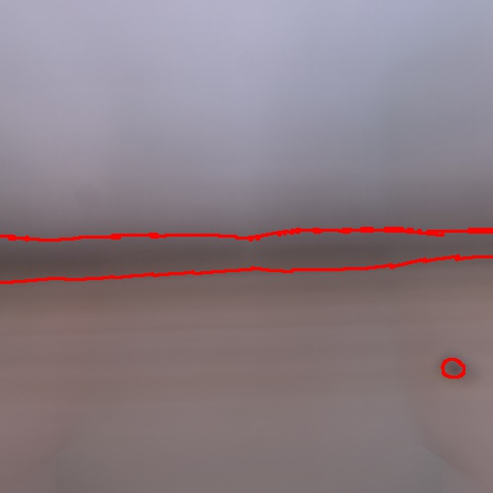
Step 4 : Smear Detection
The Fig.5 depicts the final result and the contour highlights the smear detected in the sequence of input images.
Fig.5 Smeared Image

Slide 12
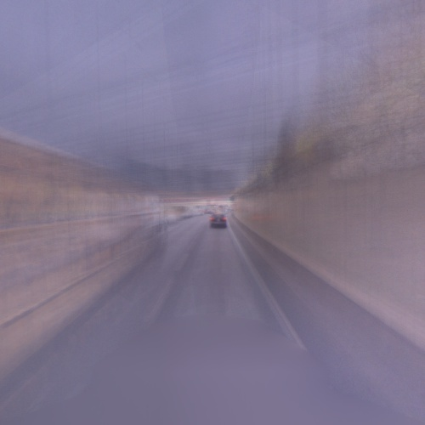


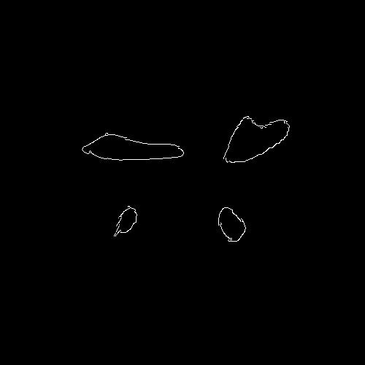
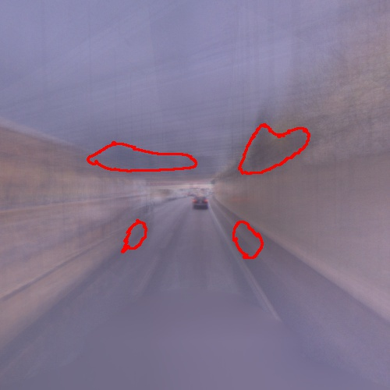
Sample Output:
For better understanding the script is executed with limited images and we get the following as the output.
Average
Gaussian
Threshold
Edge Detection
Final Output

Slide 13
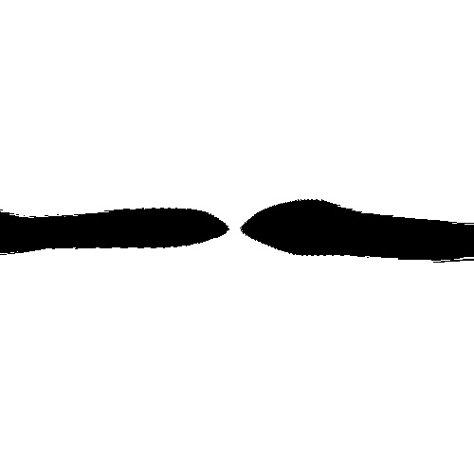

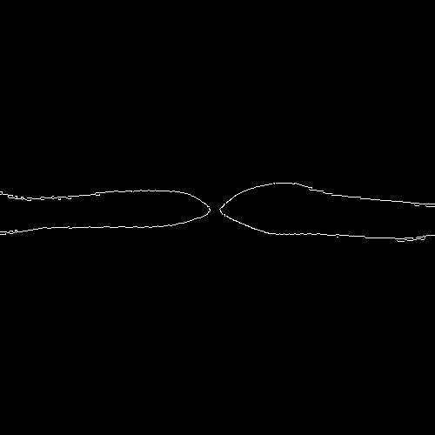
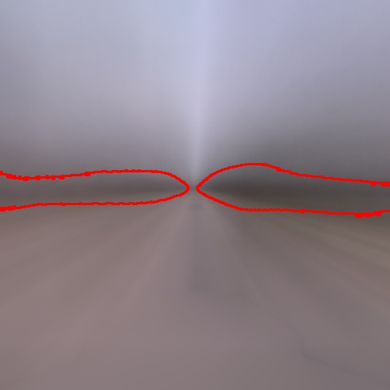

Sample Output:
Adaptive Threshold Image
Average Image
Edge Detection Image
Final Output Image
Gaussian Filtering Image

Slide 14
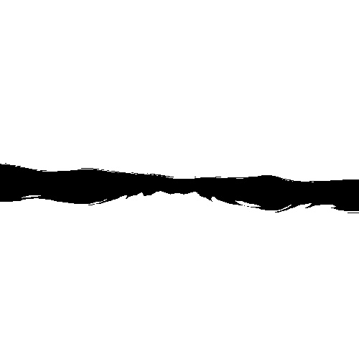

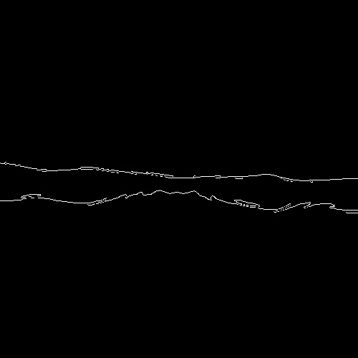
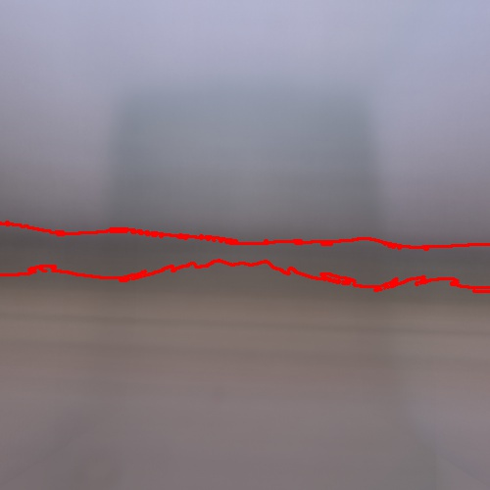

Sample Output:
Adaptive Threshold Image
Average Image
Edge Detection Image
Final Output Image
Gaussian Filter Image

Slide 15
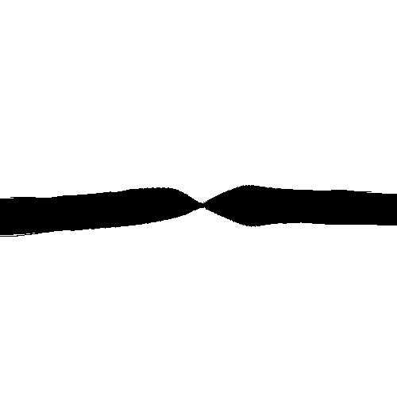

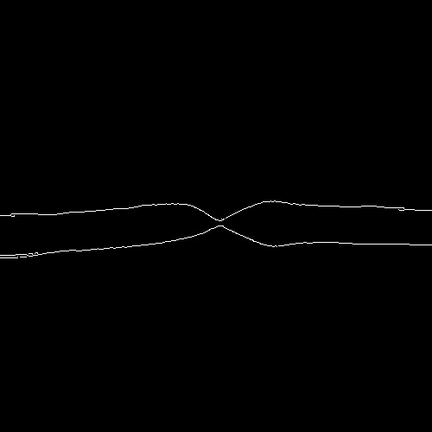
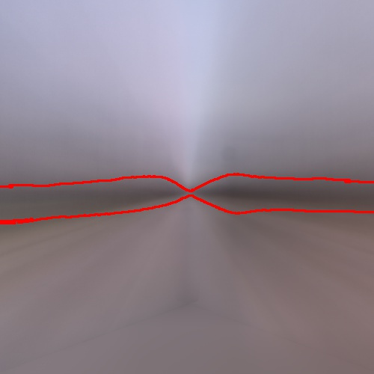

Sample Output:
Adaptive Image
Average Image
Edge Detection Image
Final Output Image
Gaussian Filter Image

Slide 16
Sample Output:
Adaptive Threshold Image
Average Image
Edge Detection Image
Final Output Image
Gaussian Filtering Image

